Slide 2
Extracorporeal or Systemic Therapies Section

Slide 3
Objectivies
Understanding the Extracoporeal or systemic therapy section
Understand Extracoporeal or systemic therapy section Specific Guideline & Coding Tips
Clinical examples for better understanding
Knowledge Check

Slide 4
Definition
There are 11 types of root operation in this section.
Atmospheric Control: Extrcorporeal control of atmospheric pressure and composition
Decompression:Extracorporeal elimination of undissolved gas from body fluids
Electromagnetic Therapy:Extracorporeal treatment by electromagnetic rays
Hyperthermia:Extracorporeal raising of body temperature
Hypothermia:Extracorporeal lowering of body temperature
Perfusion:Extracorporeal treatment by diffusion of therapeutic fluids
Pheresis:Extracorporeal sepration of blood products
Phototherapy:Extracorporeal treatment by light rays
Shock wave therapy:Extracorporeal treatment by shock waves
Ultrasound therapy:Extracorporeal treatment by Ultrasound
Ultraviolet Therapy:Extracorporeal treatment by Ultraviolet

Slide 5
Coding Tip
First character for this section is value 6
Second character for bodysystem is “A” (i.e) Physiological system
Third character is root operation, There are 11 as discussed above
Fourth character specifies where the therapy performed
Fifth character denotes how many times the procedure perforemed single or multiple
Sixth character is No qualifier for this section except for “Perfusion” root operation the qualifier is donor organ
Seventh character used in Pheresis root operation to specify the blood component on which is performed, In ultrasound therapy specifiy site,
Decompression R.O include only one procedure (i.e) treatment for decompression sickness in a hyperbaric chamber
Hyperthermia is used to describe both temperature imbalance an adjunct radiation treatment for cancer.

Slide 6
Contd….
When it is done for cancer treatment it is coded under radiation therapy
Pheresis is used in 2 main purpose to treat disease when too much blood component is produced eg:leukemia,and to remove blood product such removal of platelet from donor
Phototherapy involves using a machine that exposes the blood to light rays outside the body, recirculates it and then returns it to body.

Slide 7
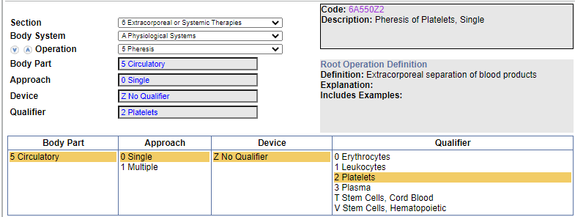
Clinical Example
Donor thrombocytapheresis, Single encounter?
Ans:6A550Z2

Slide 8
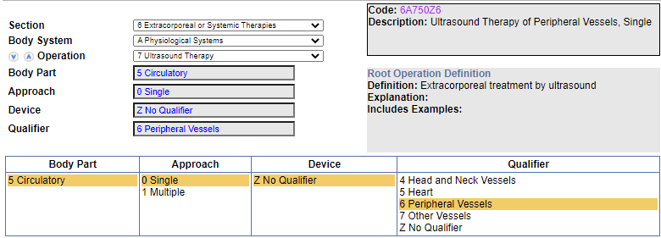
Clinical Example
Therapeutic ultrasound of peripheral vessels, Single treatment ?
ANS:6A750Z6

Slide 9
Knowledge check
Shock wave therapy of plantar fascia, Single treatment ?
Transcranial magnetic stimulation series treatment ?
Circulatory phototherapy, Single encounter?
Extracorporeal electromagnetic stimulation for urinary incontinence, Single treatment ?

Slide 10
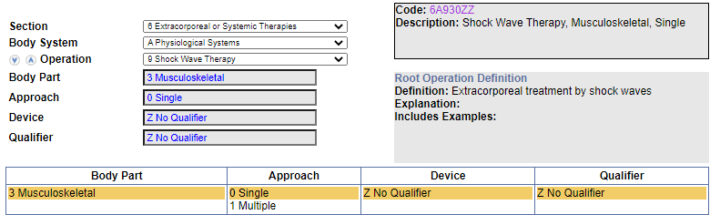
Answer
6A930ZZ
6A221ZZ
6A650ZZ
6A210ZZ

Slide 11
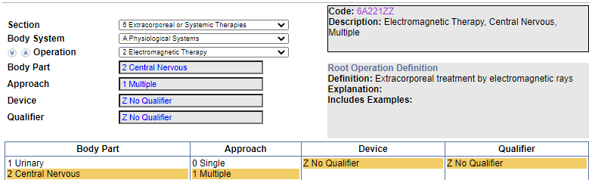
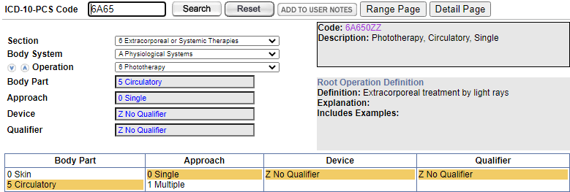

Slide 12
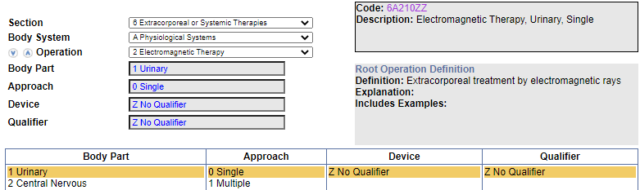

Slide 13
Thank You

